Slide 1
System Calls
System calls are the interface between user programs and the operating system kernel.
Applications cannot directly access hardware resources.
They request services from the OS using system calls.
Example: Creating files, processes, and performing I/O operations.

Slide 2
How Applications Interact with Kernel
Applications run in User Space.
Kernel runs in Kernel Space with full hardware privileges.
User programs invoke system calls to request services.
Transition from User Mode to Kernel Mode happens via software interrupt.

Slide 3
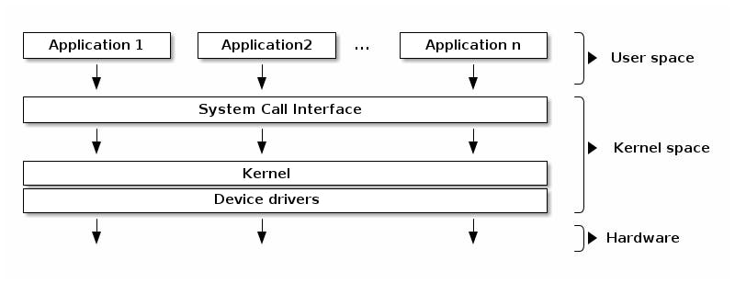
User Space vs Kernel Space

Slide 4
Types of System Calls
Category | Examples
Process Control | create process, terminate process, wait, exit
File Management | create file, open, read, write, close
Device Management | request device, release device, read/write device
Information Maintenance | get time/date, get system data
Communication | send messages, receive messages

Slide 5
Examples: Windows vs Linux System Calls
Category | Windows | Linux
Process Control | CreateProcess() | fork(), wait()
File Management | CreateFile(), ReadFile() | open(), read(), write()
Communication | CreatePipe() | pipe(), shmget()

